Slide 1

SurgiBox Squad
SurgiBox Mini
May 9th, 2024
Alex, Brandon, Grace, Livia, and Samiksha
Notes:
Samiksha

Slide 2
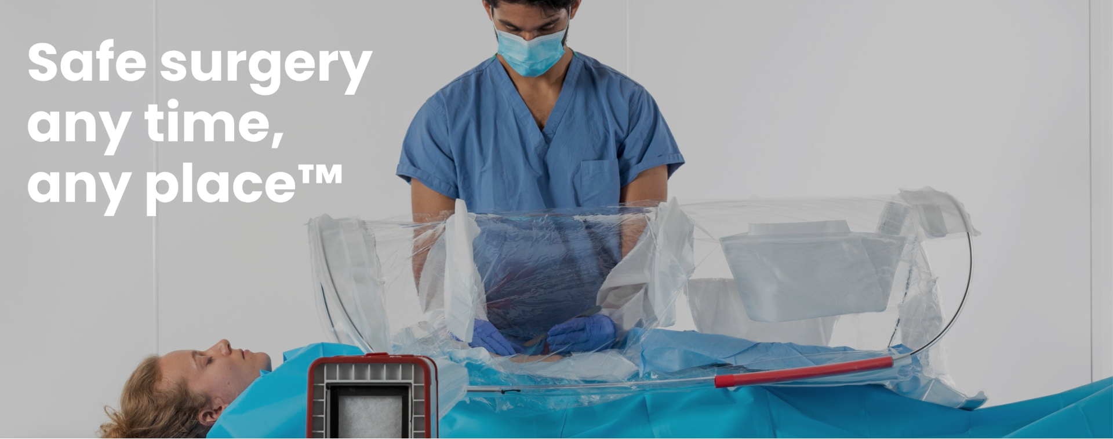
Notes:
Samiksha
●18 million fatal outcomes a year from delayed surgical care
●SurgiBox introduced a portable sterile system

Slide 3
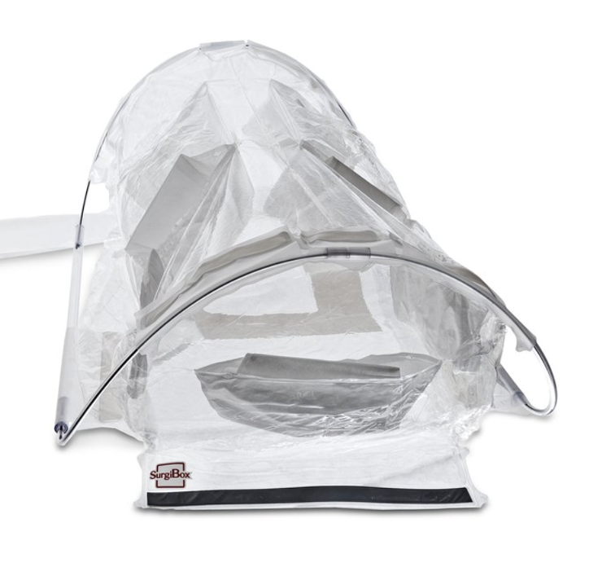
Project Plan
The current SurgiBox model isn’t well suited for minor procedures.
There is a need for a smaller SurgiBox that still optimizes the original’s critical features.
Notes:
Samiksha

Slide 4
Design Requirements
 | Target
Top Visibility | High Clarity
Setup Time | < 2 min
Folded Volume | 83.25 in^3
Dispose Time | < 1 min
Shelf Life | 2 years
Same surgical spacing | Yes
Structural integrity | Yes
Notes:
Livia

Slide 5
Brainstorming
Shapes
Saddle
Triangle frame with plastic openings
Trapezoidal
Rectangular
Circular
Mechanism
Click-pole “molecule”
Spinning popup
Inflatable layers
Hinges
Collapses sideways
Collapses like an umbrella
Notes:
Livia

Slide 6
Pugh
Chart
Mechanism | Saddle Physics | Pop Up | Click into Place | Molecule Design
Ease of Prototyping | S | - | + | +
Ease of manufacturing | S | S | S | +
Time to set up | S | + | + | +
Ease of Disposal | S | - | S | +
Total | 0 | -1 | 2 | 4
Shape | Saddle | Trapezoid | Rectangular | Half-Cylinder | A-frame
Ease of prototyping | S | + | + | + | +
Ease of Manufacturing | S | + | + | S | +
Visible Clarity | S | - | - | S | -
Stability | S | S | S | S | -
Total | 0 | 1 | 1 | 1 | 0
Notes:
Livia

Slide 7
Progress since DR2
Design Review 2 Feedback
Consider how the model will fold when sleeves and an adhesive bottom is added
How will it be affected by the hose on the side?
Try to obtain more accurate metrics for how sturdy the Surgibox needs to be.
What have you learned?
The pop-up design would be more preferable, as it is fewer parts to manufacture
To test how easily one is able to use the Surgibox, try cutting a chicken or playing cards inside it
In addition to the four main sleeves, we also need to keep the magnetic opening at the base of the Surgibox
Notes:
Brandon

Slide 8
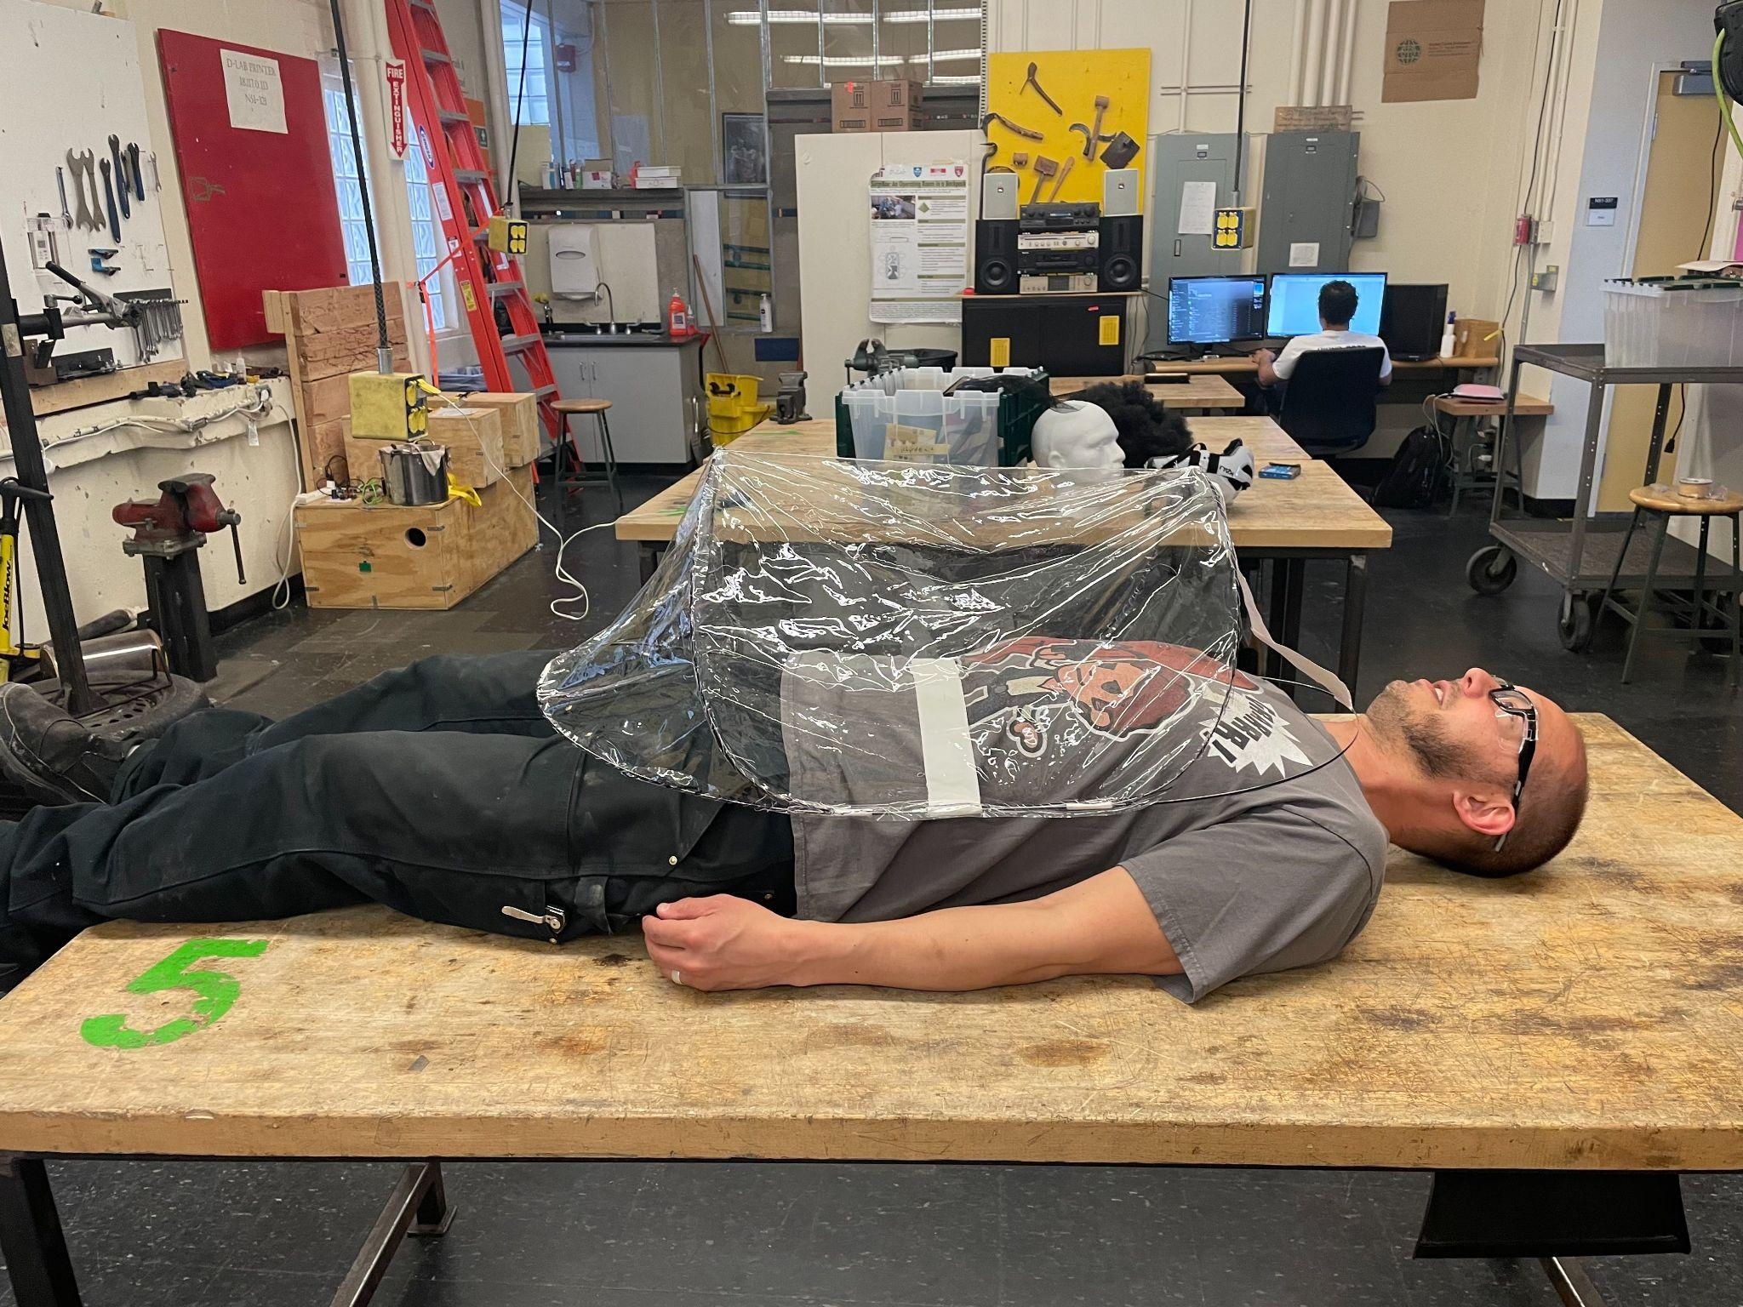
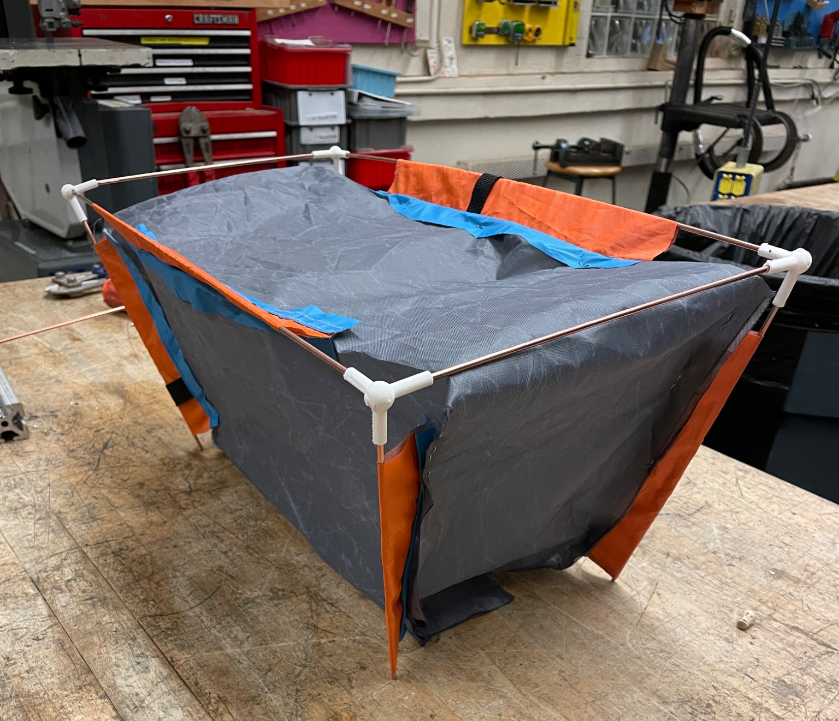
Where we left off
Molecule Design
Trapezoidal origami
Stiff frame
Popup Design
Similar to original shape
Foldable frame material
Notes:
Grace (or Brandon?)

Slide 9
Arbitration
Ultimately, we chose POP-UP MODEL
faster assembly
new pop-up feature :)
Both practical
high visibility
stability
surgical spacing
Notes:
Grace/ Brandon

Slide 10
Our Current Model
Features
Provides high quality sterile barrier system
Over 45% reduction in size
Hyperbolic pop-up design w/ spring steel frame
Lightweight and disposable
4 individual sleeves w/ comfortable layout for operation
Unobstructed view of operating area
Ample space inside for a smaller scale procedure
Magnetically sealed port for transport of tools/materials
Medical grade adhesive surgical drape
Port for existing air filtering technology
Notes:
Alex

Slide 11
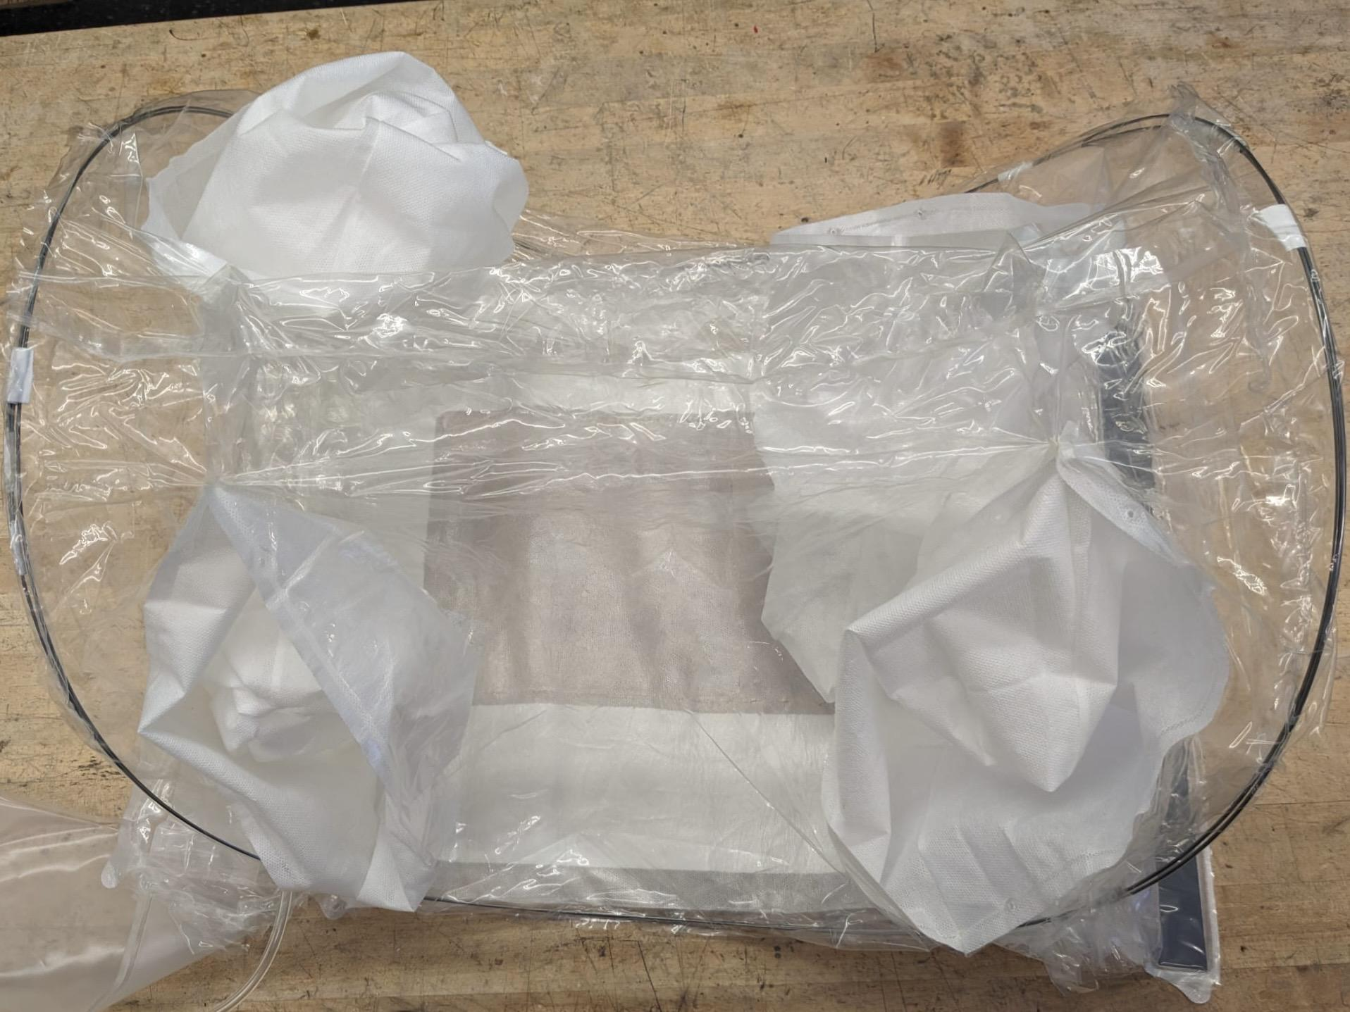
Our Current Model
45% size reduction
4 arm ports
Spring steel frame
Adhesive surgical drape
Clear view of operation
Air filter port
Larger magnetic port
Notes:
Alex

Slide 12
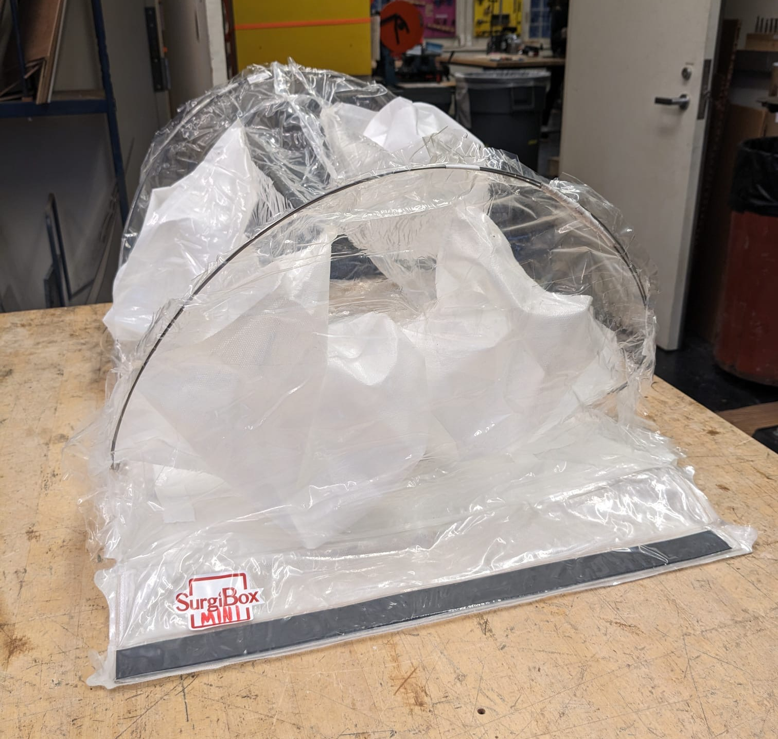
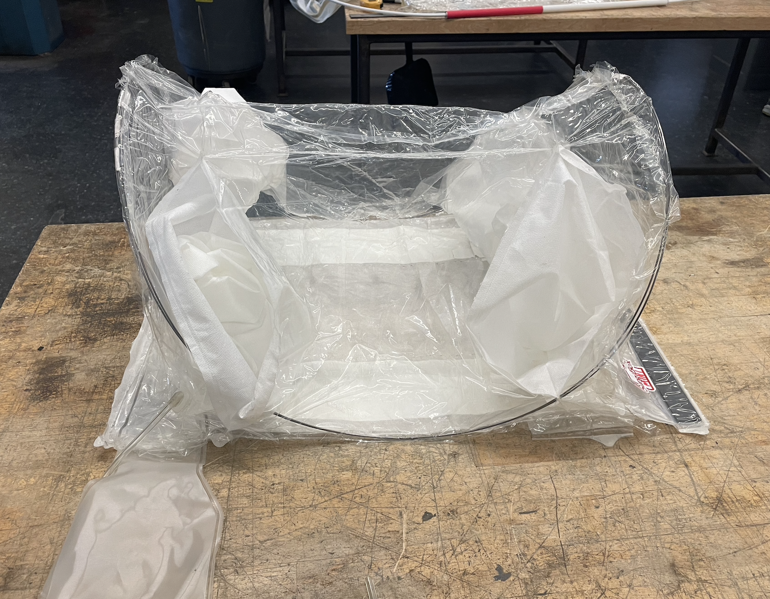
Our Current Model
Length
Height
Width
Notes:
Alex

Slide 13
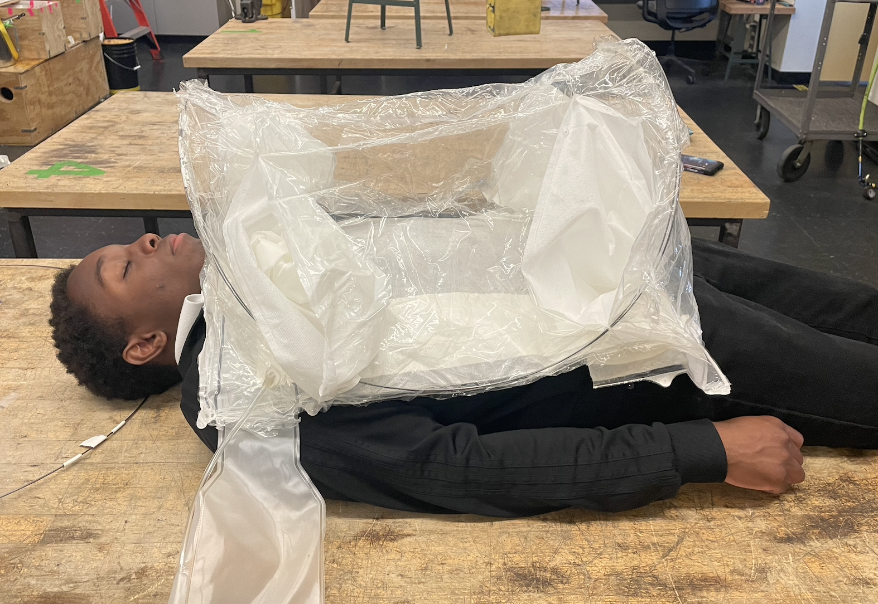
Our Current Model
Notes:
Alex

Slide 14
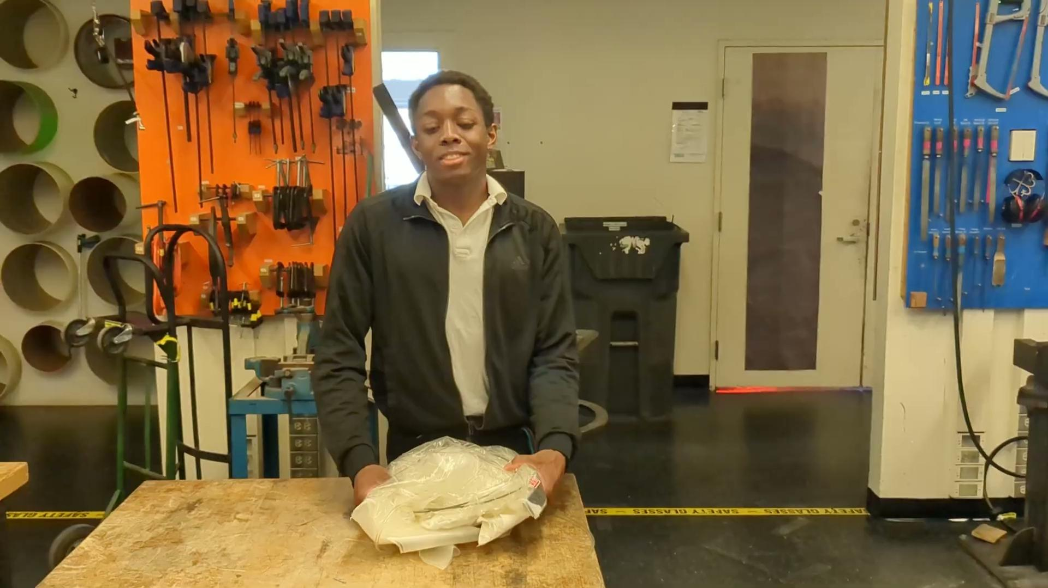
Video
Notes:
Alex

Slide 15

Video
Notes:
Alex

Slide 16
Notes on Prototype
For the sake of this prototype, we repurposed the large bubble. However, some differences would be:
Top seam would not be needed
Blood bags would still attach on sides
Surgical drape area of operation will be smaller
Notes:
Alex

Slide 17
Prototype Testing
 | DR 2 Popup | Current Popup | Target
Top Visibility | High Clarity | High Clarity | High Clarity
Setup Time | 9.76 s | 9.37 s | < 2 min
Folded Volume | 132 in^3 | 286 in^3 | < 624 in^3
Shelf Life | N/A | 2 years | 2 years
Same surgical spacing | ✓ | ✓ | ✓
Structural integrity | N/A | ✓ | ✓
Notes:
Grace / Livia

Slide 18
Technical Risks
Material Selection
Rigidity of frame during operation
  Clarity from creases becomes more variable if frame is not as rigid
Lifetime of frame and maintaining desired shape
Manufacturing
Bubble design and curves makes manufacturing process more difficult
Welding curves
Notes:
Livia

Slide 19
Budget
Item Name | Cost | Quantity | Subtotal
Pop-Up Tent | $38.99 | 1 | $38.99
Nitinol Wire (Thin) | $11.71 | 1 | $11.71
Nitinol Wire (Thicker) | $22.96 | 1 | $22.96
Bag Sealer | $9.98 | 1 | $9.98
Clear Repair Tape | $11.98 | 1 | $11.98
Total spent: $95.62
Free items, provided by Surgibox & DLab: spring steel, Piano Wire, Old Surgibox Units, synthetic whalebone, TPU
Notes:
Brandon / Livia

Slide 20
Next Steps
→ Next steps
create more complete prototype (see next slide)
test with surgeons to get “feel” for dimensions + visibility
adapt adhesive patch to accommodate specific surgeries
→ → Grand scope
manufacturing feasibility
other features
→ lighting 💡
→ blood recovery bags 🩸
Notes:
Grace / Livia

Slide 21
References
https://dddrop.com/wp-content/uploads/2020/06/TPU-Filament-Technical-Data-Sheet.pdf
https://www.sciencedirect.com/science/article/abs/pii/S014294181831002X#:~:text=As%20compared%20to%20virgin%20TPU,backbone%20and%20increased%20contact%20area.

